Slide 1

Lesson 4.2: Static Lists
Microsoft Philanthropies TEALS Program
Introduction to Computer Science

Slide 2
Static lists
After this lesson, you will be able to...
Create static lists.
Access elements of a list.
Add and remove elements from a list.

Slide 3
Today’s Plan
Do Now
Lecture and introduce activity
Grammar Activity
Debrief and wrap-up
Notes:
Duration Description
5 minutes | Do Now
15 minutes | Lecture and introduce activity
25 minutes | Grammar Activity
10 minutes | Debrief and wrap-up

Slide 4

Do Now 4.2: Letters of a word
Go to this starter project, read and run the script.
Once you understand how it works, modify the script so that the sprite says every letter in the word.
Notes:
Go to this starter project - http://snap.berkeley.edu/snapsource/snap.html#present:Username=whuangpha&ProjectName=Starter%20project%20for%20text%20operators%20practice

Slide 5

Lecture
List Review
Let’s brainstorm a list of ways lists could be useful
Notes:
Review the concept of a list from the previous lesson
Ask students to brainstorm examples of when lists could be useful
To store an unknown number of values (e.g. a bunch of student test scores, shopping list, the songs of your favorite music artist)
To store a collection of related values as one entity (e.g. the number of absent students each day over a week, how often a video on YouTube in a week)

Slide 6
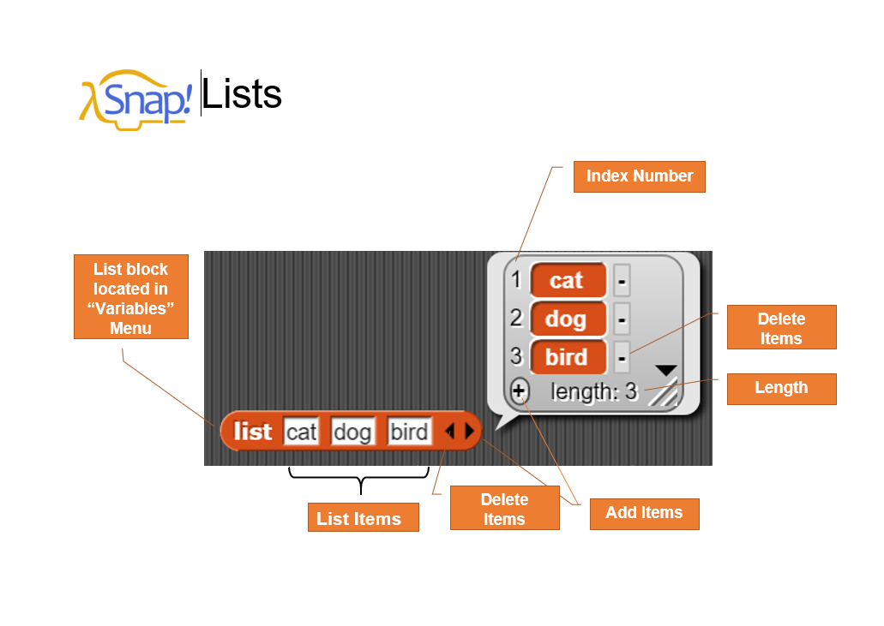
Demonstration
Notes:
Go over the Snap! Lists Components with the students
Demonstrate creating lists in Snap!s
Use the variadic (taking a variable number of arguments) “list” block to create a simple list
Point out the format in which lists are displayed (gray box with red elements)
Show that lists can be assigned to variables like other values
Emphasize that the list is considered a single value, even though it consists of multiple values
Point out and explain basic list operations blocks
The “item,” “add,” and “delete” blocks will be most important. The “length” block will be useful as well.
Point out that these blocks all take a list as an argument.

Slide 7
Demonstration – Creating Lists
Notes:
Demonstrate creating lists in Snap!
Use the variadic (taking a variable number of arguments) “list” block to create a simple list
Point out the format in which lists are displayed (gray box with red elements)
Show that lists can be assigned to variables like other values
Emphasize that the list is considered a single value, even though it consists of multiple values
Point out and explain basic list operations blocks
The “item,” “add,” and “delete” blocks will be most important. The “length” block will be useful as well.
Point out that these blocks all take a list as an argument.

Slide 8

Lab 4.2 You Talkin’ to Me?
In this lab you will create a simple sentence generator using lists. Let’s Talk,
Create a variable for each part of speech listed below and set each variable to hold a list of words that fit that part of speech.
Part of Speech | Example words
noun | giraffe, monkey, boy, girl, elephant, ...
verb | jumps, runs, sleeps, sits, dances, ...
adjective | big, small, loud, silly, young, old, sleepy, ...
adverb | quickly, excitedly, angrily, happily, sadly, ...
article | a, the
preposition | under, over, around, near, beside, ...
Notes:
Students should complete the You Talkin' to Me? activity individually or in pairs
Encourage students to be creative with their word lists
Don't allow students to fixate on the exact grammatical correctness of generated phrases and sentences
If this is a major concern, choose words for the lists such that generated phrases will always be grammatically correct

Slide 9
Lab 4.2 You Talkin’ to Me? – Reporting Phrases
Reporting Phrases
Write a custom reporter block called “noun phrase” that reports a noun phrase where each word is chosen randomly from the lists you created.
A noun phrase consists of an article, an adjective, and a noun in that order.
Write custom reporter blocks like “noun phrase” for each of the phrase types listed below.
Phrase type | Construction
prepositional phrase | preposition, noun phrase
verb phrase | adverb, verb, preposition phrase
sentence | noun phrase, verb phrase

Slide 10
Lab 4.2 You Talkin’ to Me? – Making Sentences
Making Sentences
Write a script so that when you press the space bar, a random sentence is generated, and a sprite says the resulting sentence.
BONUS: Modify your script so that a noun phrase can either be the construction from part 1.2 or a single proper noun (e.g. a person's name). Your script should randomly decide which version of a noun phrase to use.
BONUS: Modify your script so that a verb phrase can sometimes leave out the prepositional phrase. Your script should randomly decide to include the prepositional phrase or not.

Slide 11
Lab 4.2 You Talkin’ to Me? – Changing our vocab
Changing Our Vocabulary
Write a script so that when the 'n' key is pressed, the user is prompted for a new noun and that noun is added to list of nouns. After that point, the new noun entered by the user should be able to appear in sentences.
Write a script to add words to the other lists. Use the keys listed
Write a script so that when the 'x' key is pressed, the user is asked for one of the parts of speech and then for a number (n).
Key | Part of speech
v | verb
j | adjective
d | adverb
a | article
p | preposition

Slide 12
Lab 4.2 You Talkin’ to Me? – Changing our vocab
Your script should remove the nth item from the list of words for the specified part of speech.
For example, if the user types in "verb" and "3" then you should remove the 3rd word from the list of verbs.
The removed word should no longer appear in sentences.
4. Save your project as Lab4.2.

Slide 13

Debrief Discussion
Student volunteer to present and discuss their solution to each step
Notes:
Ask a student to present and discuss their solution to each step
Emphasizes uses of lists and encourage students to discuss and think about why lists were necessary
Ask students to consider if the tasks would have been doable without lists

Slide 14

Exit Ticket
In your notebook answer the following:
Could the tasks in this lesson have been done without lists.
Discussion: Share what you were having trouble with

